Slide 1
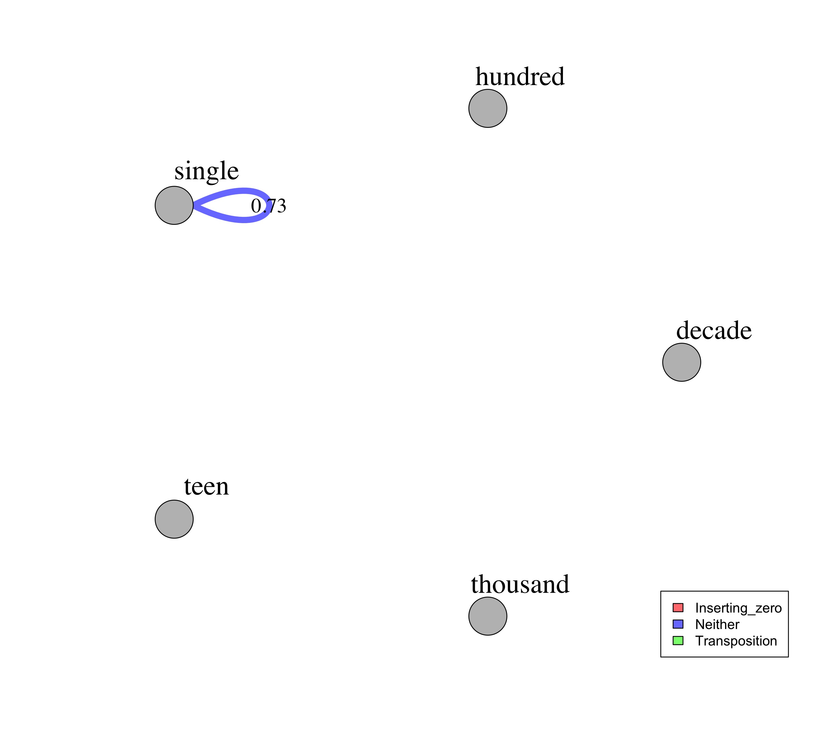
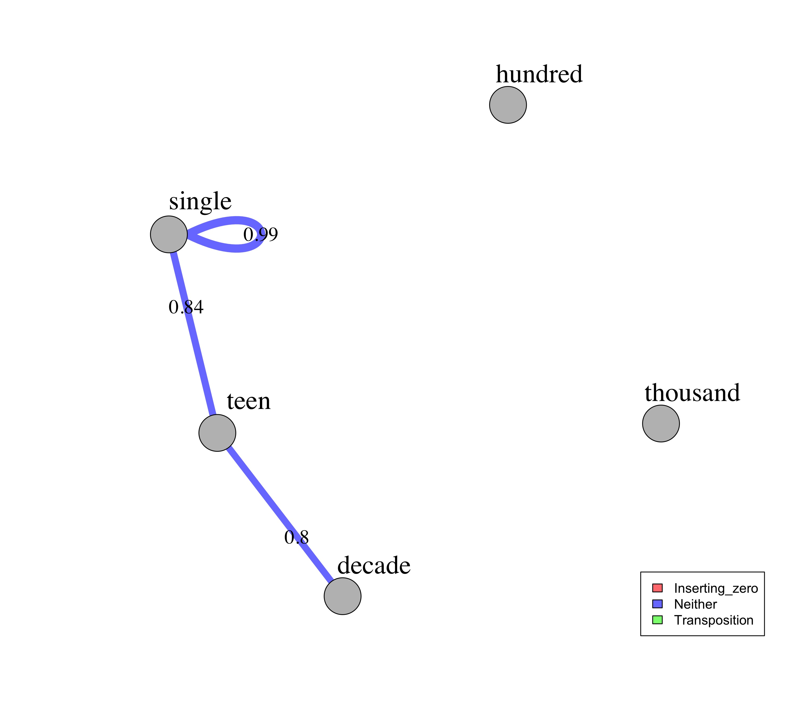
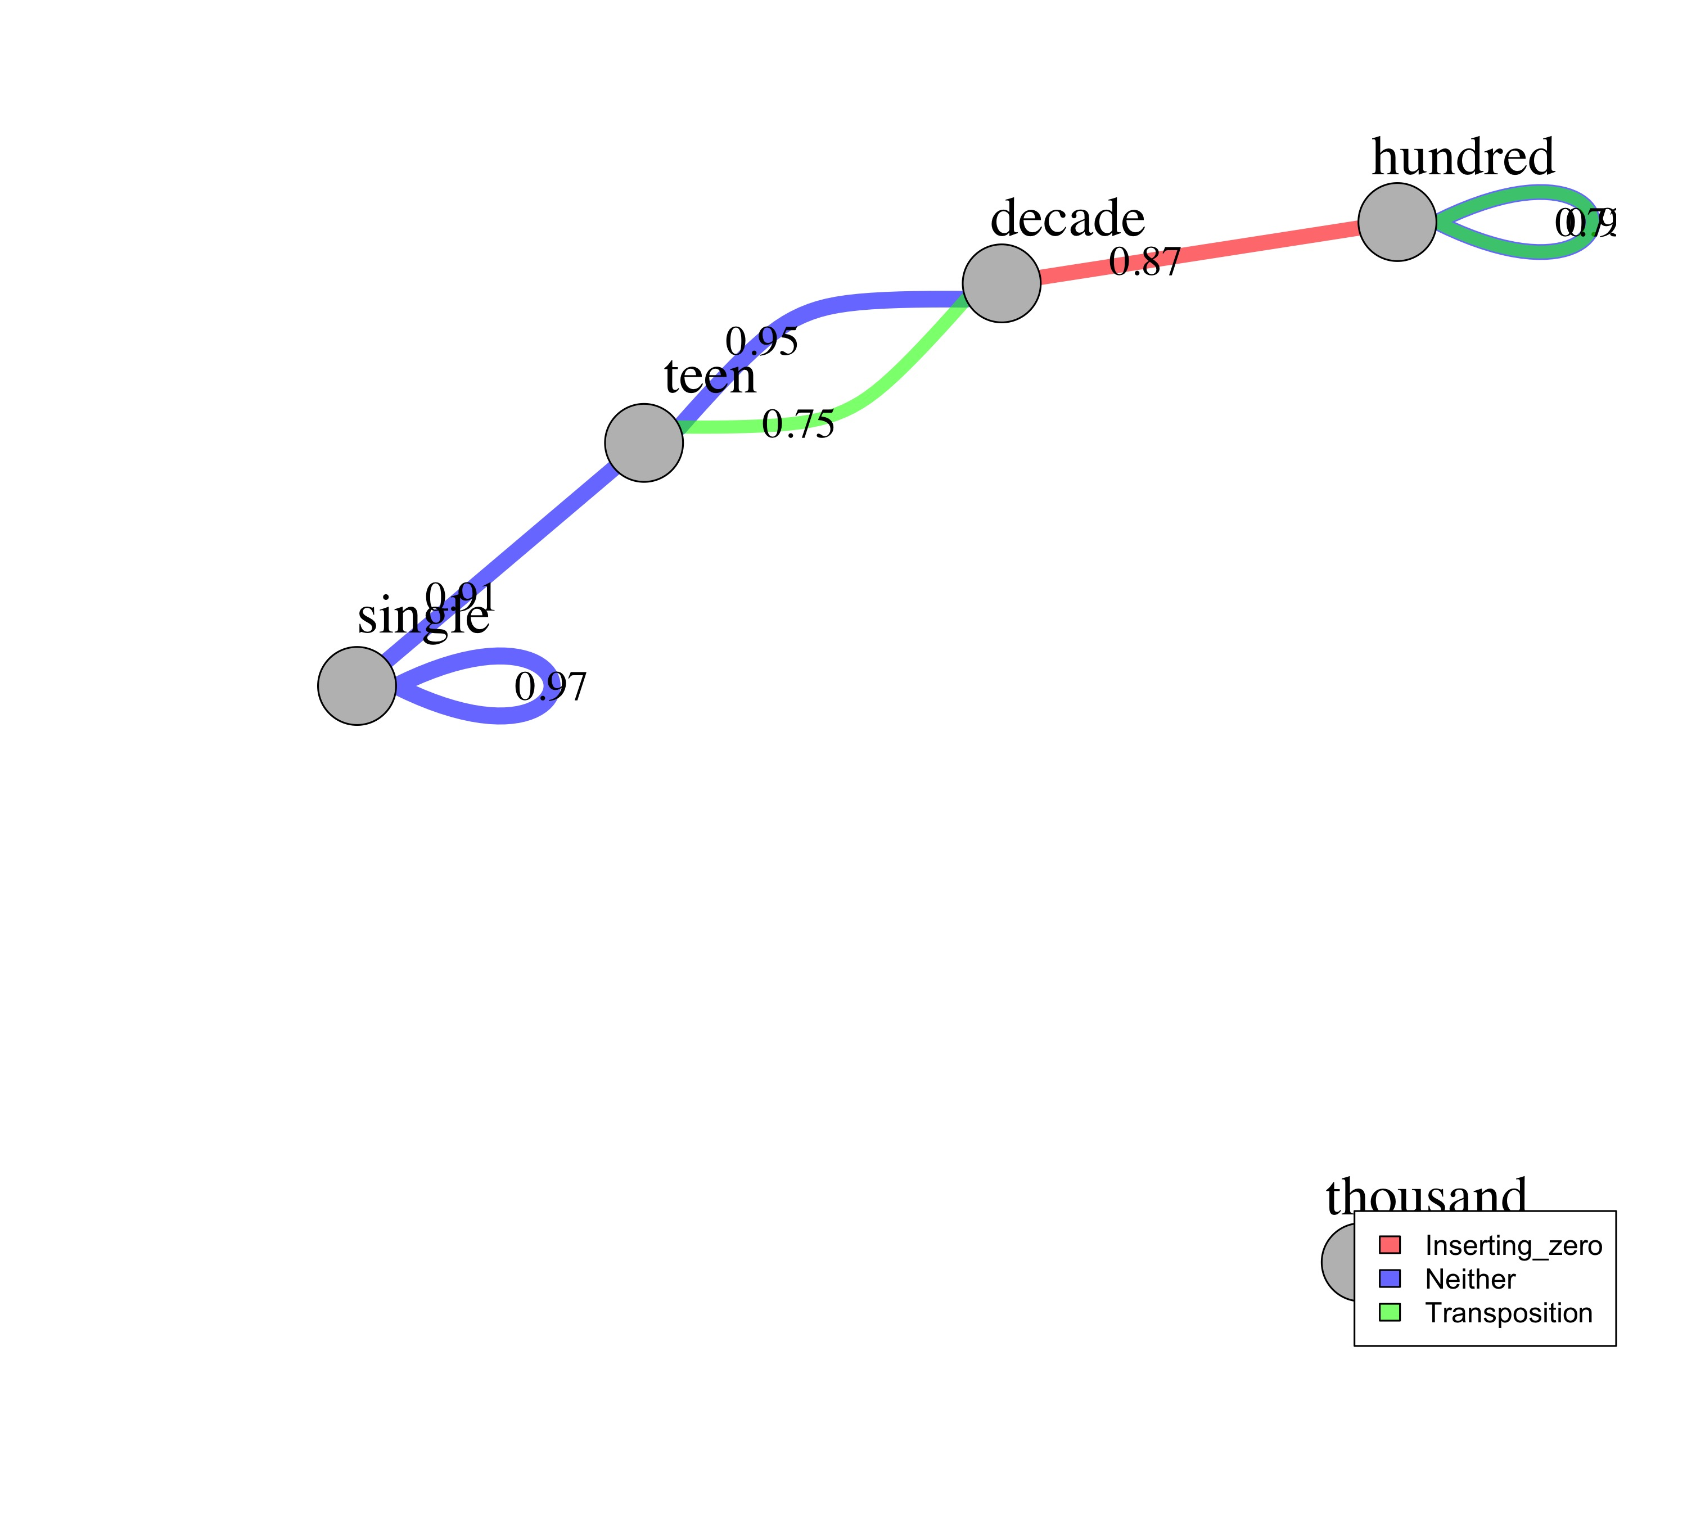
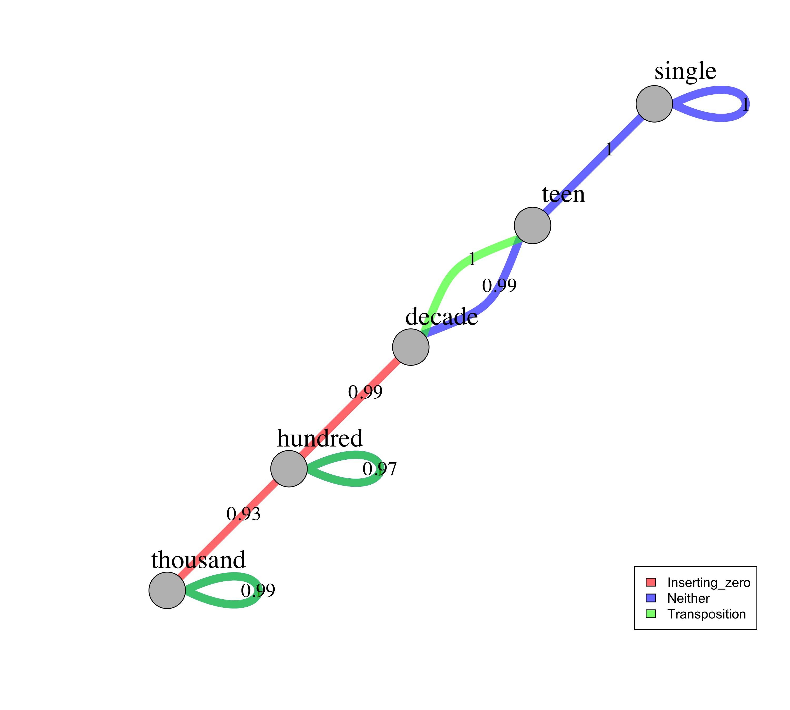
The Which-N task
Quartile 1
Quartile 2
Quartile 3
Quartile 4

Slide 2
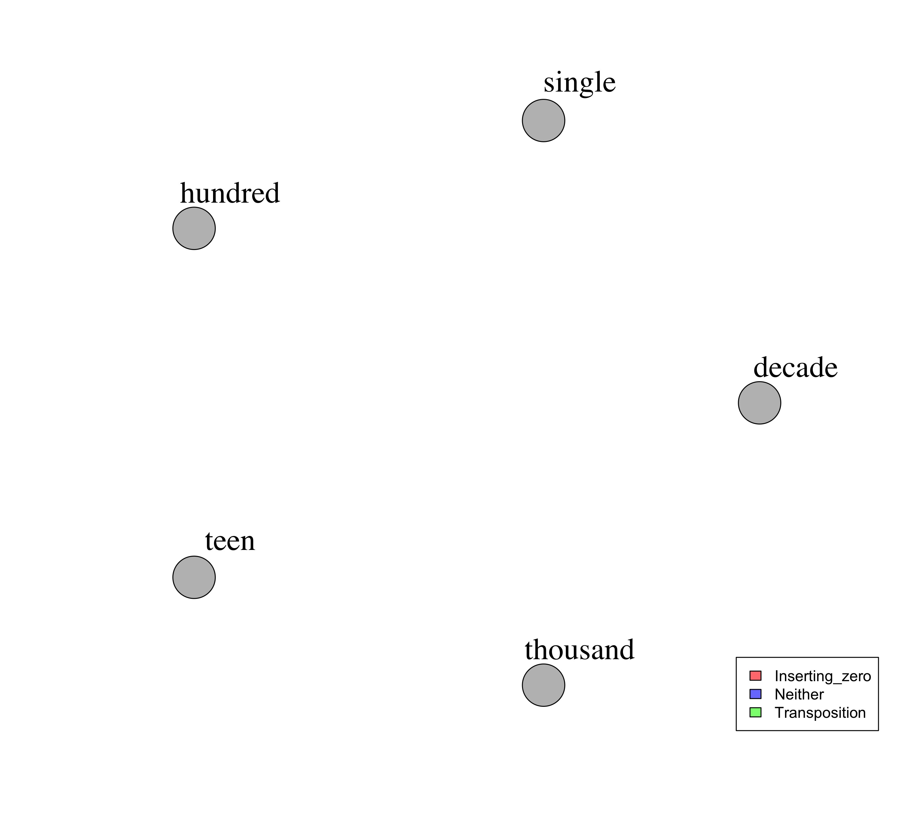
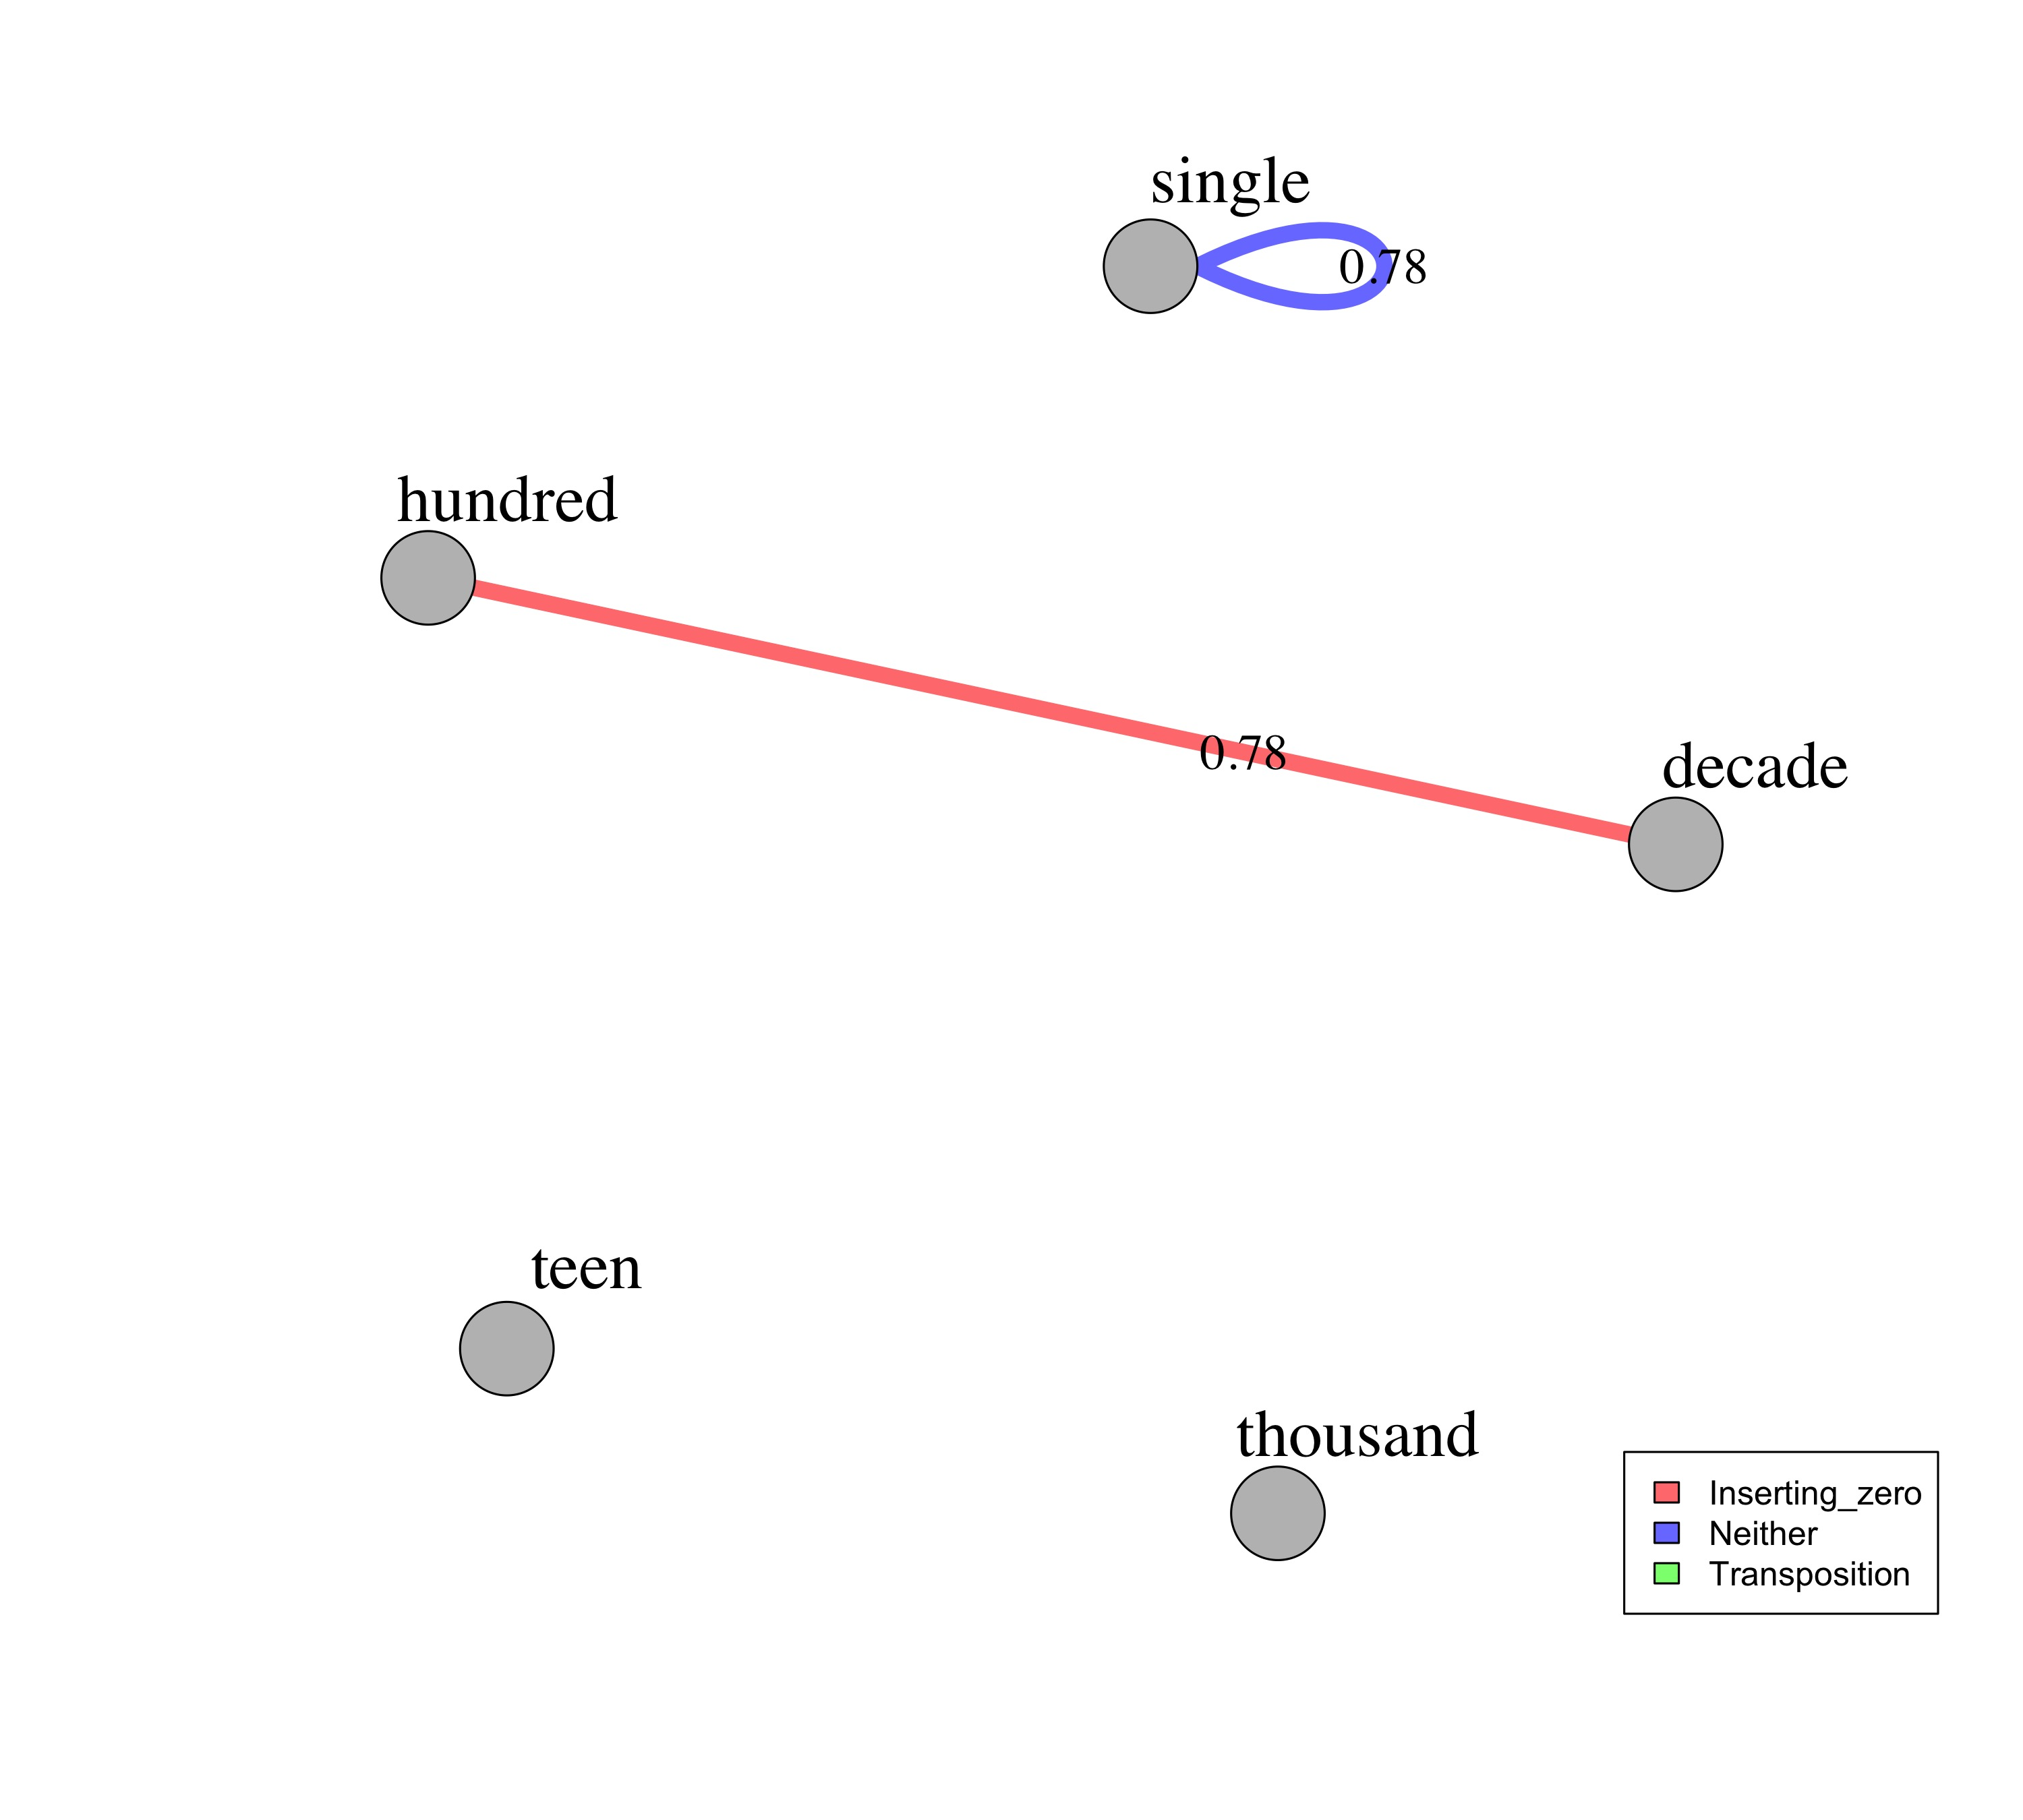
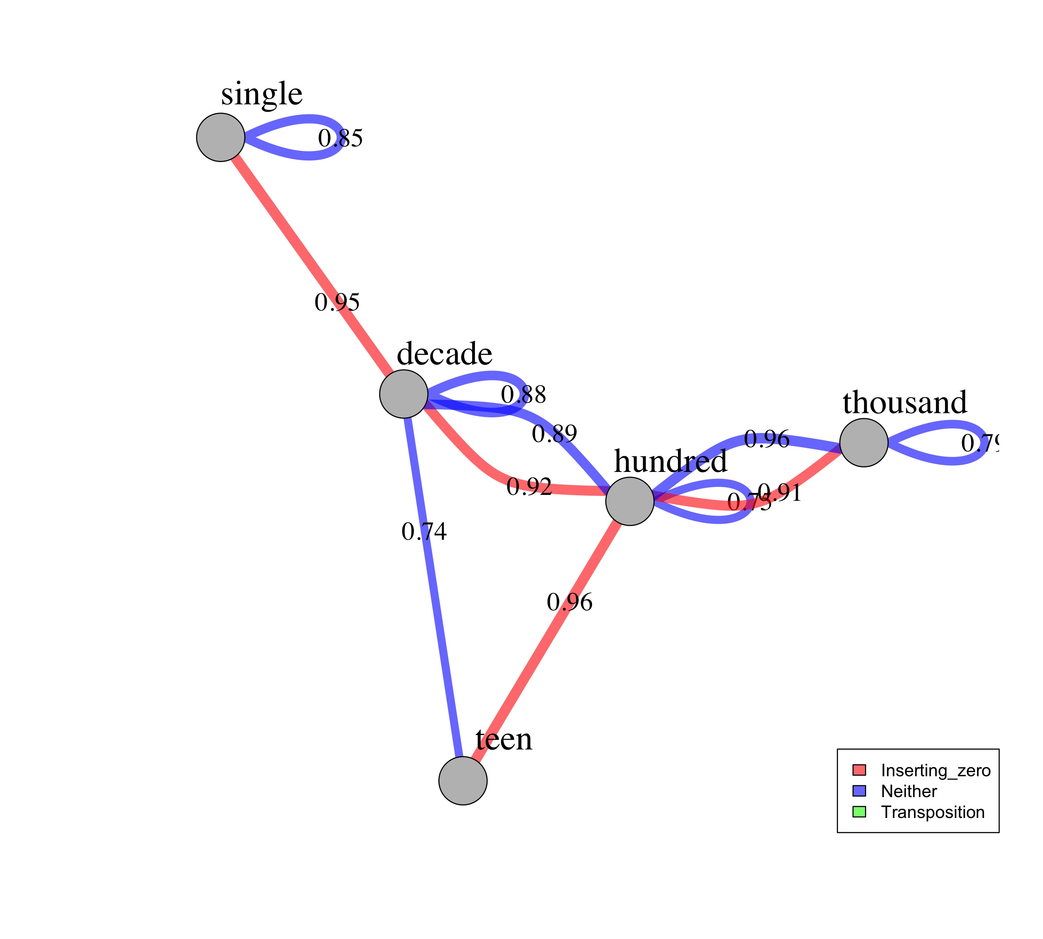
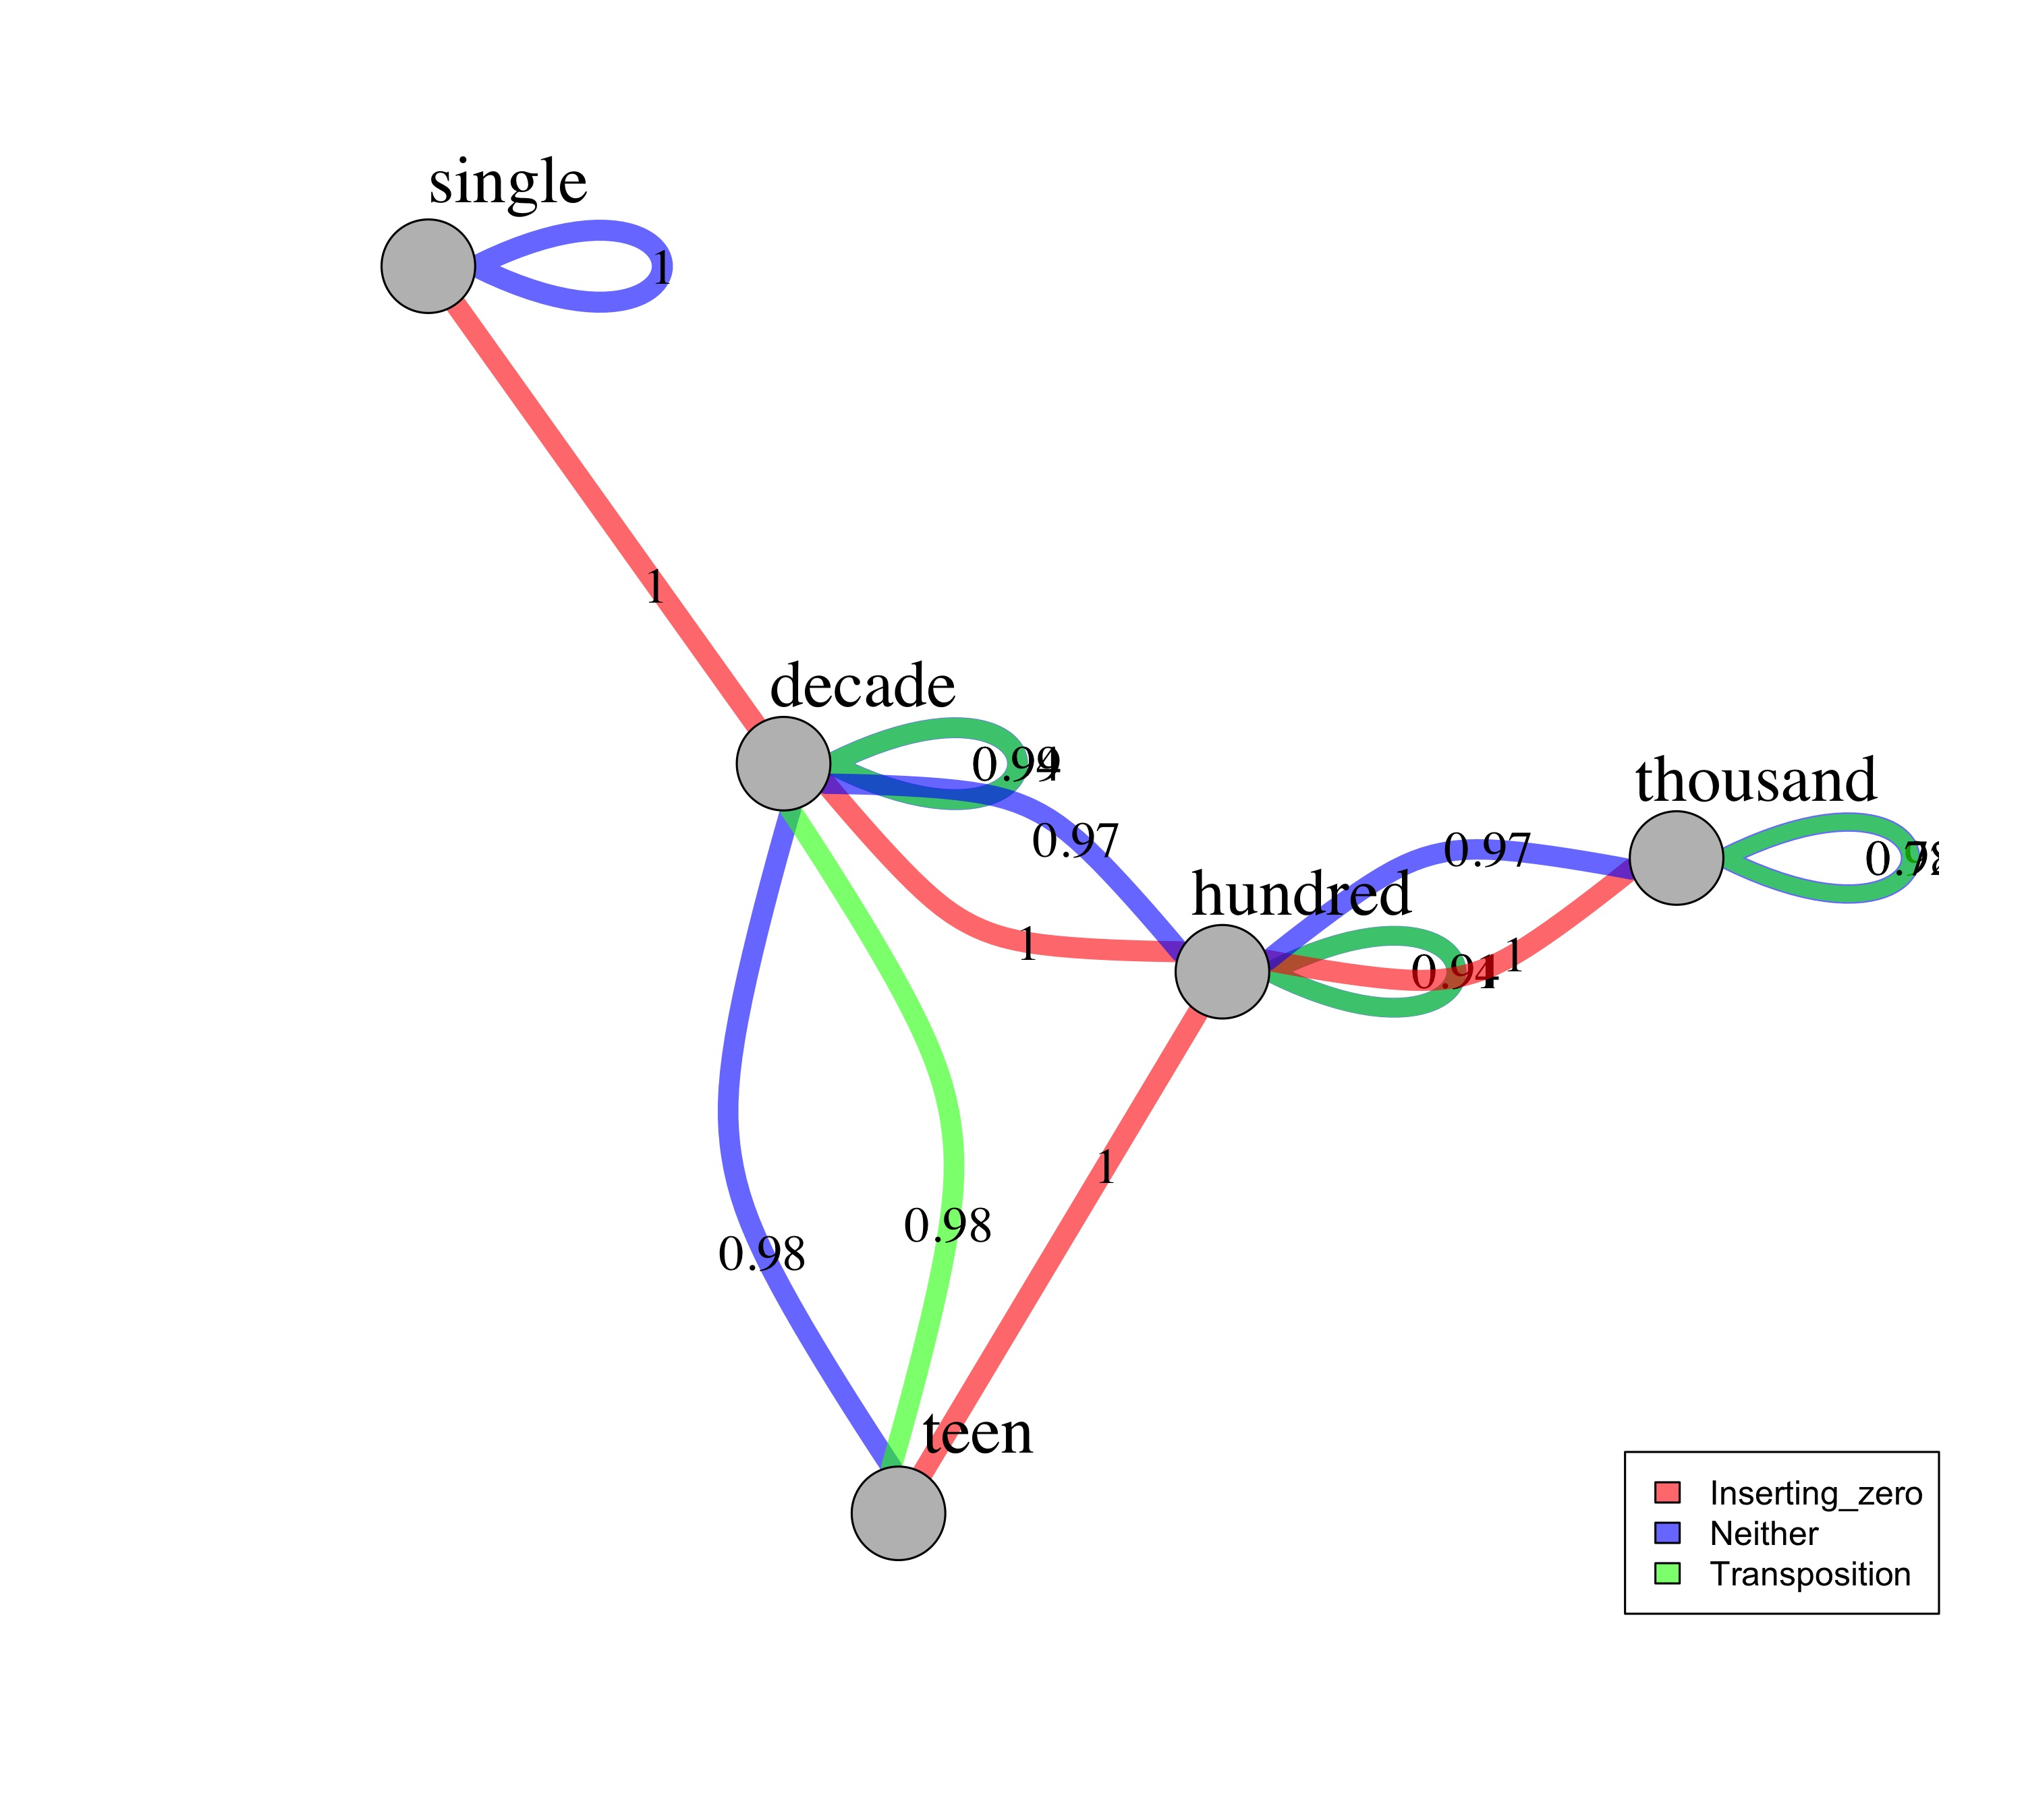
The Which-More task
Quartile 1
Quartile 2
Quartile 3
Quartile 4

Slide 3
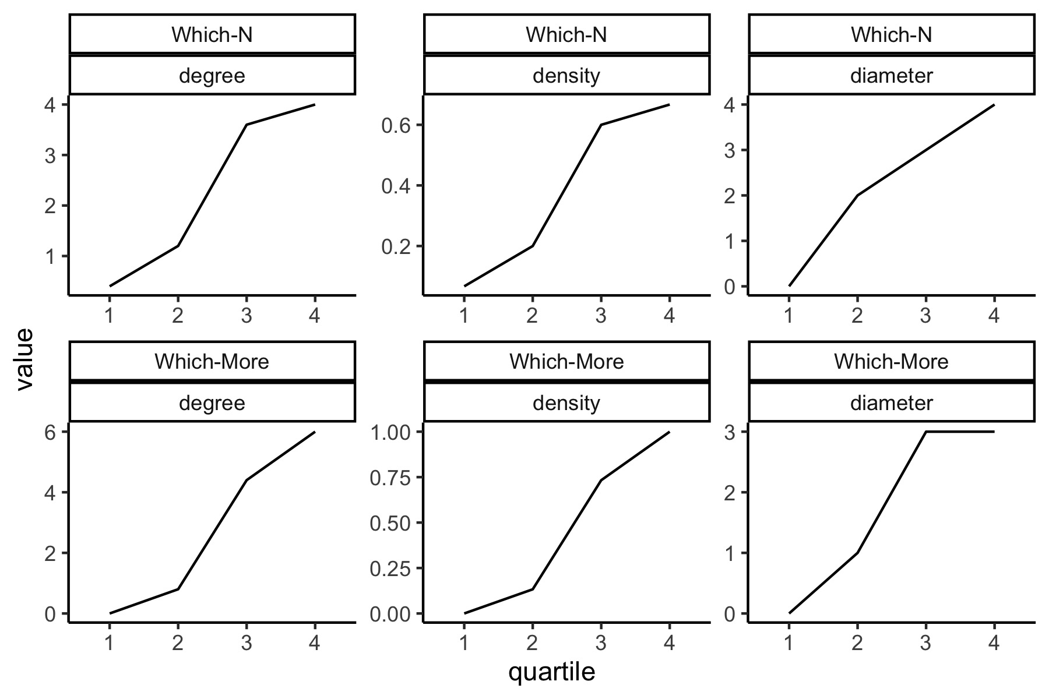
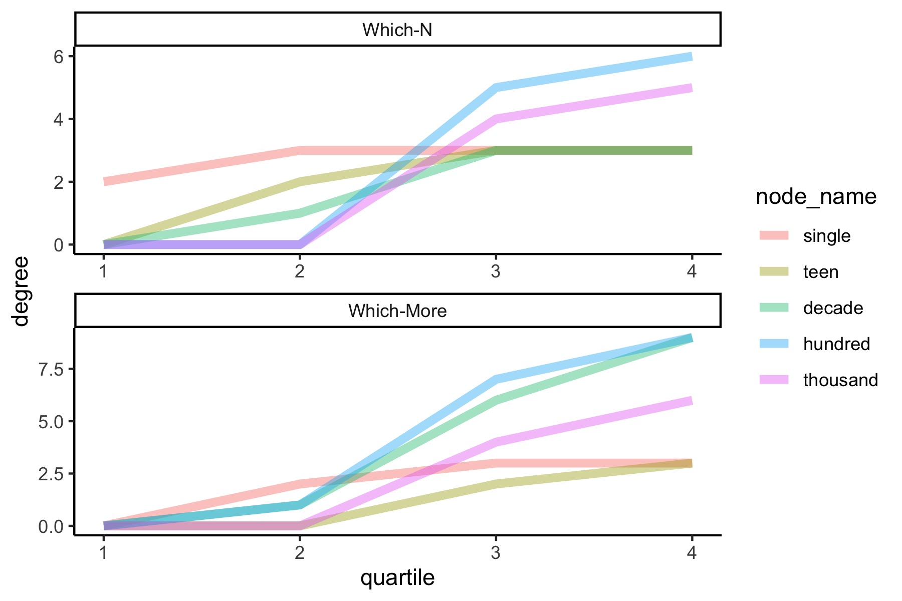

Slide 4
Item: 364 v 436
Analysis 1:
M-SP-with-T (multi-digit number with same number of places and transpositions
Singles are easier. Show zeros and transpositions are hard,
Physical length is important for the which-More task
Analysis 2:
hundred vs. hundred
Transpositions
Shows how individual components emerge--numbers in different ranges, zeros and transpositions--and how get integrated into one system
N: linearly, zerso and transpositions are incorportated later with smaller numbers faster.
M:
Analysis 3:
Shows an increasing complex knowledge structure with different features prominent in different stages
Both regularities and idiosyncrasies
Item: 201 v 21
Analysis 1:
M-DP (multi-digit number with different number of places
Analysis 2:
hundred vs. decade
inserting zero)
Analysis 3:
1. The highest place value unit among the two choice numbers | 3
2. The number of digits in each number within the pair | 2 v 3
3. Whether the two choice numbers have different length | Yes
4. Whether the two number differ in the insertion of “0” | Yes
5. Whether only one digit is different and is not “0” | No
6. Whether the item involves transposition of individual digits | No
1. The highest place value unit among the two choice numbers | 3
2. The number of digits in each number within the pair | 3 v 3
3. Whether the two choice numbers have different length | No
4. Whether the two number differ in the insertion of “0” | No
5. Whether only one digit is different and is not “0” | No
6. Whether the item involves transposition of individual digits | yes

